Slide 1
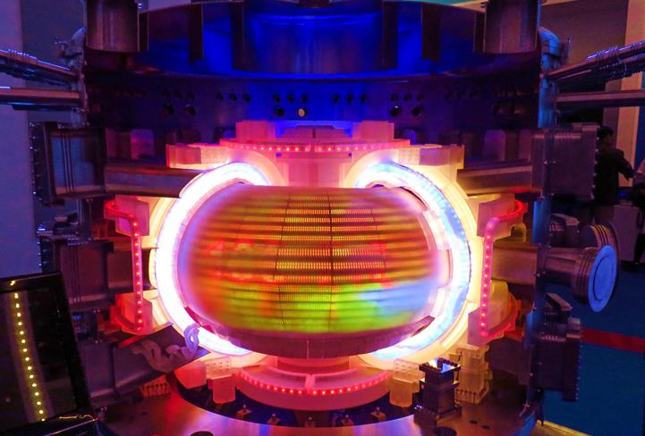
June 21, 2022
Nuclear Fusion: Progress, Prospects, and Innovation Opportunities
Axel Meisen, C.M., FCAE, P.Eng., EurIng
President, Fusion Energy Council of Canada
axel@meisen.ca

Slide 2
Fusion Fundamentals
Helium
(⁴He)
Deuterium
(²H)
Tritium
(³H)
Neutron
(n)

Slide 3
1. Background
Fusion | ²H | + | ³H | → | ⁴He | + | ¹n | 17.5 | MeV
Breeding | ¹n | + | ⁶Li | → | ⁴He | + | ³H | 4.8 | MeV
Overall | ²H | + | ⁶Li | → | 2 ⁴He |  |  | 22.3 | MeV
Feedstock requirements (kg/year) for a 1 GW fusion plant
 | Theoretical (Thermal) | Practical (Electricity)
Deuterium, ²H | 30 | 90
Lithium, ⁶Li | 90 | 270
Tritium, ³H | tbd | tbd

Slide 4
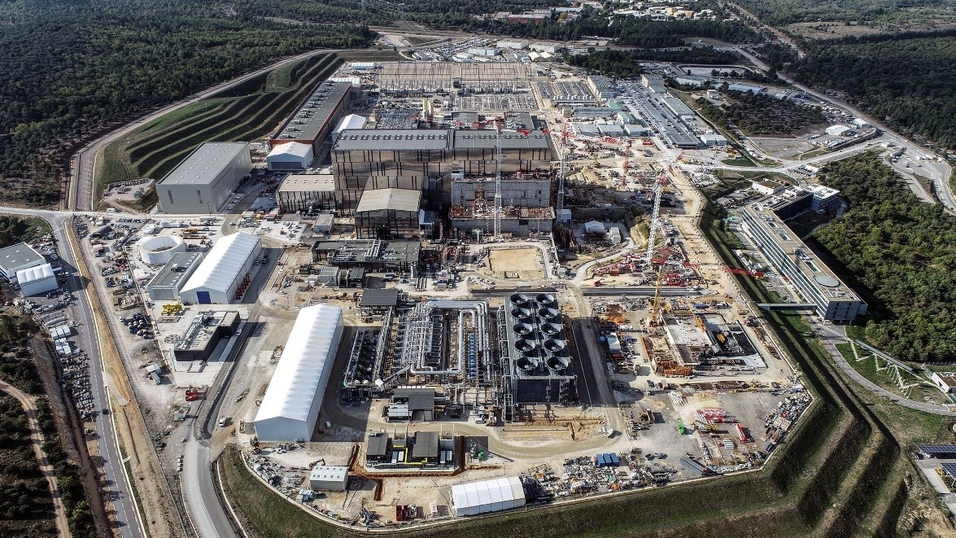
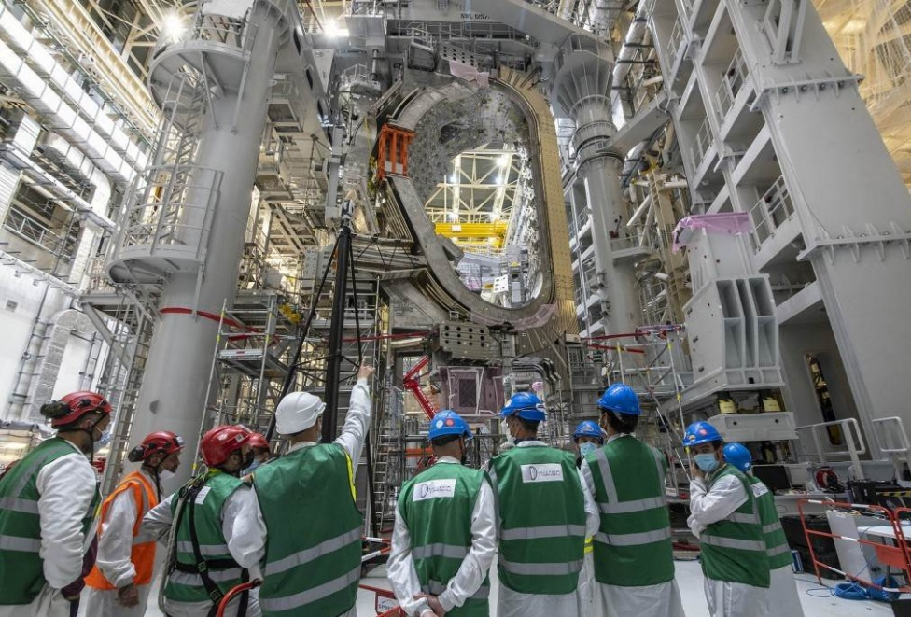
Fusion Progress: ITER
Date | Activity
2006 | Signature of the ITER Agreement
2007-2009 | Land clearing and levelling
2010-2014 | Ground support structure and seismic foundations for Tokamak
2014-2021 | Construction of Tokamak Building
2010-2021 | Construction of ITER plant and auxiliary buildings for First Plasma
2020-2025 | Main assembly phase 1
Dec 2025 | First Plasma

Slide 5
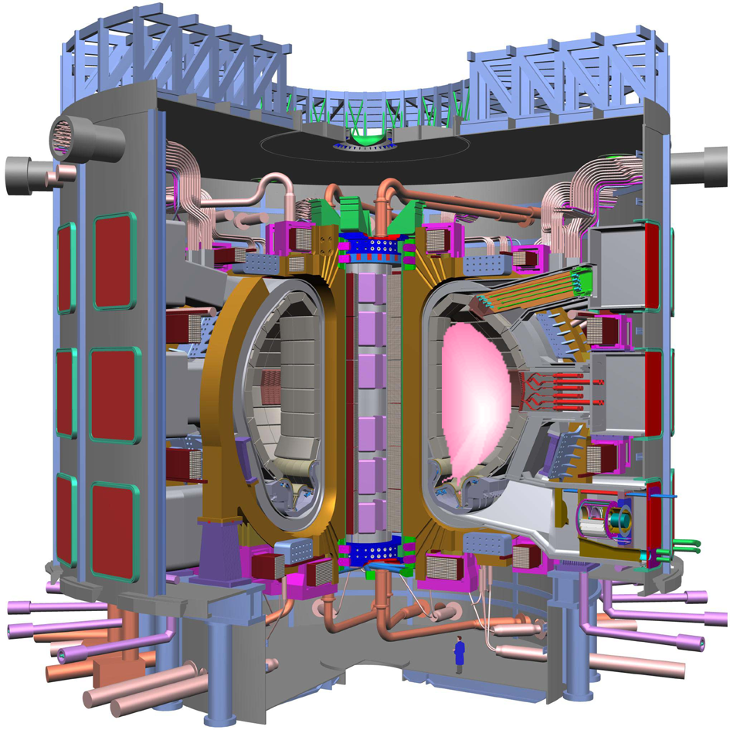
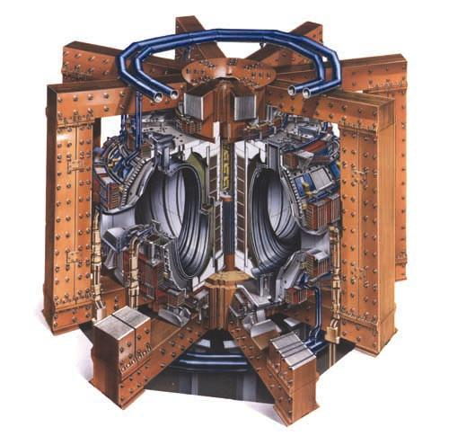
Fusion Progress: ITER (in EU) and JET (in UK)
ITER: 1,000 m³ P=500 MW Q=10
JET: 100 m³; P=16 MW; Q≈1

Slide 6
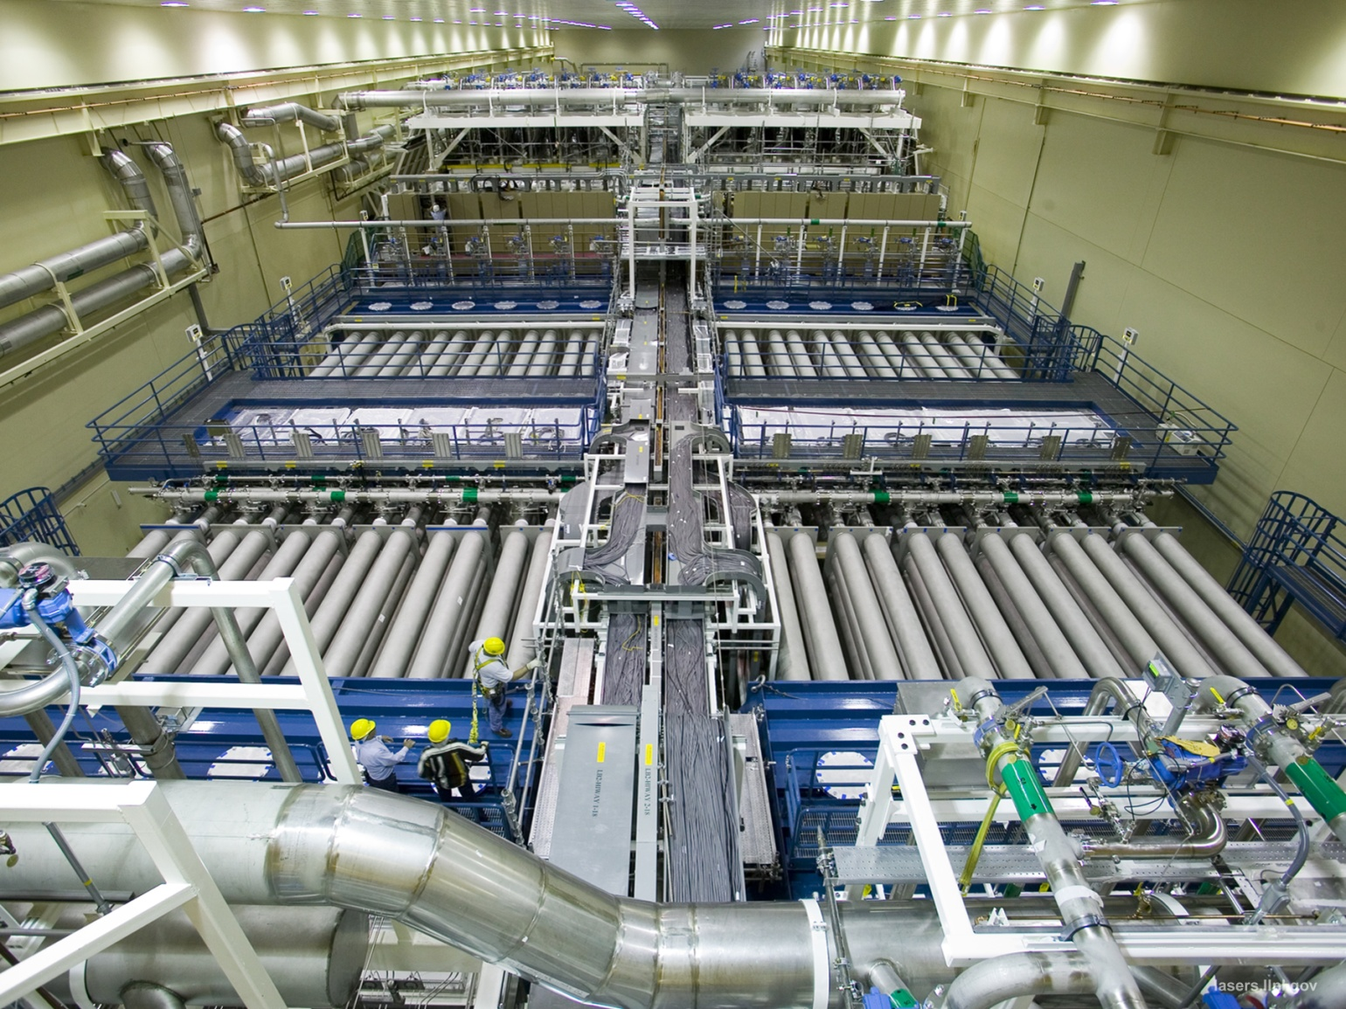
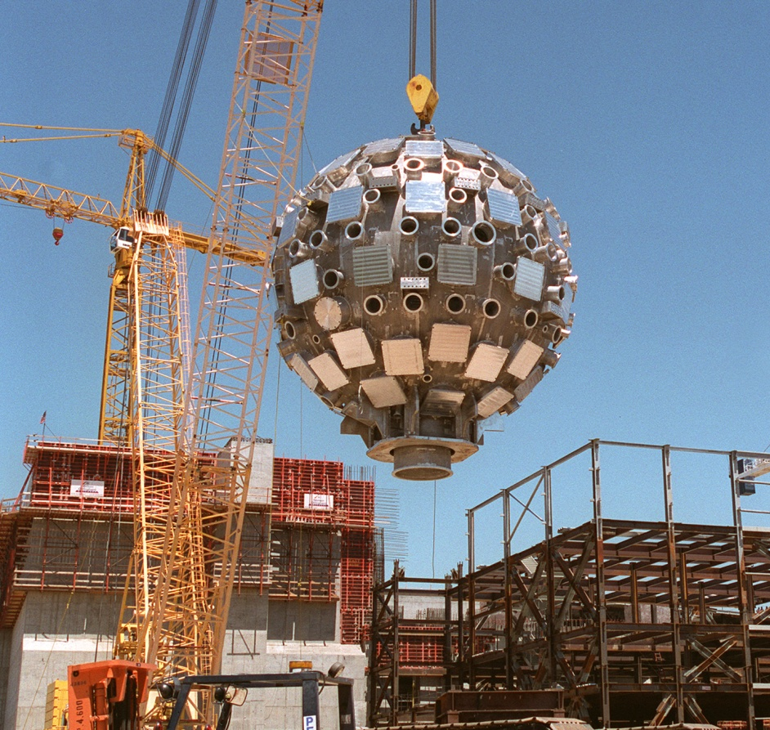
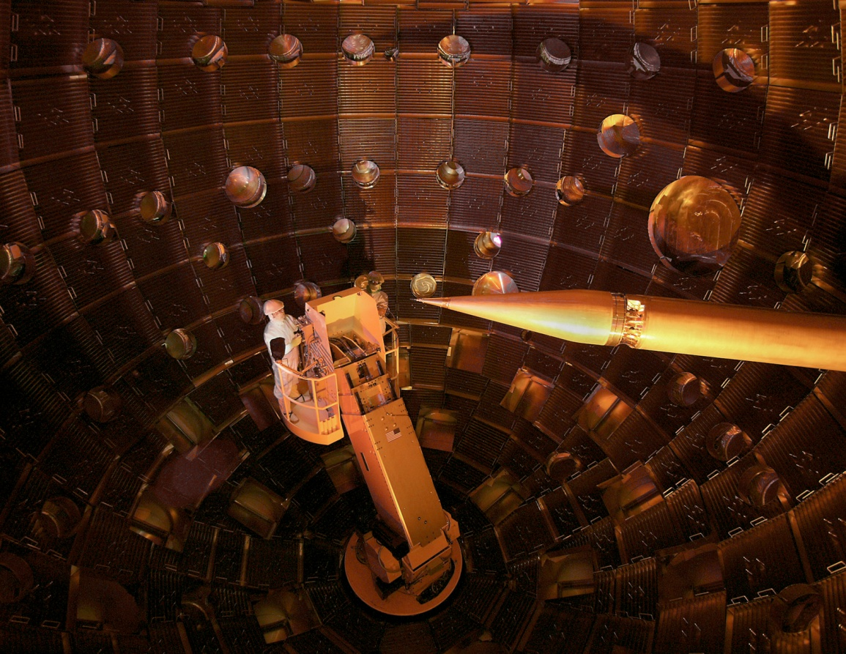
Fusion Progress: National Ignition Facility (in USA)
Lawrence Livermore National Laboratory, California

Slide 7
Fusion: Goals for 1 GW_{e} Plants and Global Activities
Capital Cost:
1 US$ Billion
940 M€
Electricity Cost (LCOE):
10 US$ / MW h
9.4 € / MW h
Private sector
investments:
>US$5 billion
Ref: IAEA Pages - FusDIS (iaea.org)

Slide 8
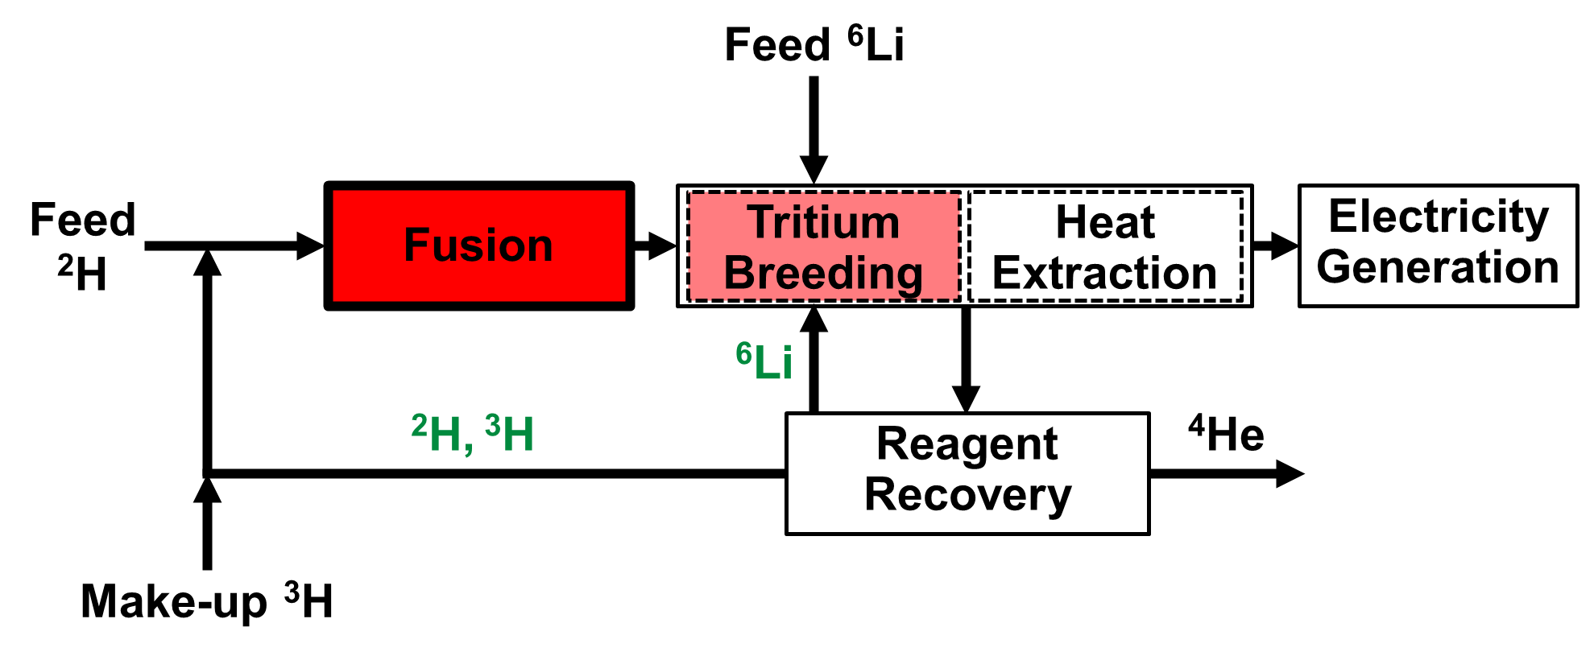
Innovation Opportunities Inside Fusion Plants
Super Magnets
High-power Lasers
Deuterium, Tritium, Lithium Recycling
Helium Separation
Neutron-tolerant Materials
Hydrogen-tolerant Materials

Slide 9
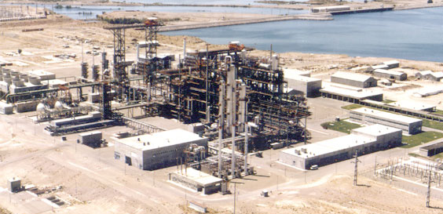
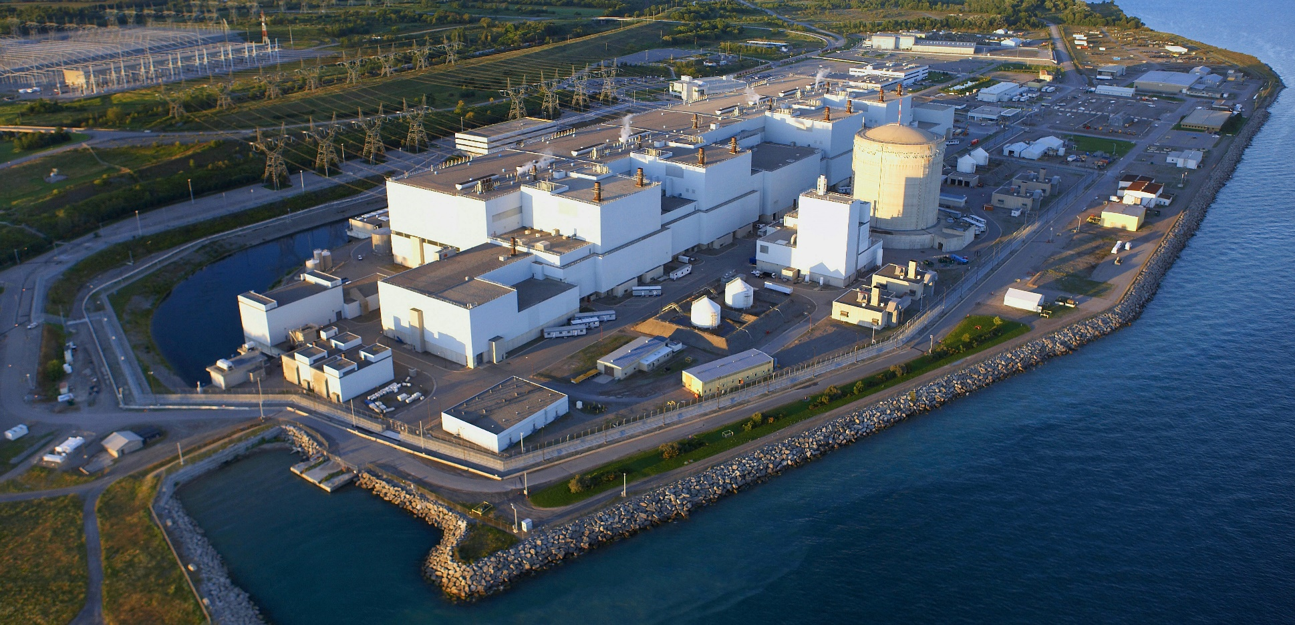
Innovation Opportunities Outside Fusion Plants
Deuterium: ENSI, Arroyito, Argentina
Tritium: OPG, Darlington, Canada
Lithium:
⁶Li 7.5% , ⁷Li 92.5%

Slide 10
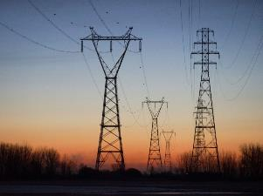
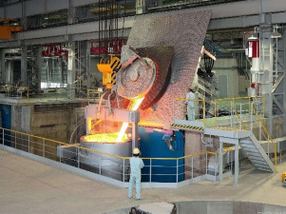
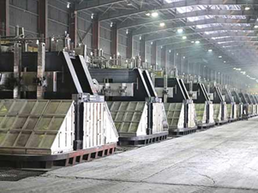
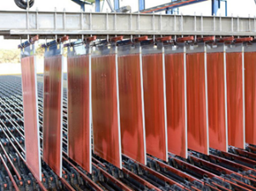
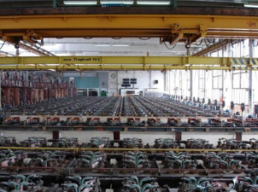
Innovation Opportunities for Fusion Energy (Electricity)
General Grid
Traditional Steel
Fusion
Electricity
Aluminum
Metal Refining
Chor-alkalis

Slide 11
Innovation Opportunities Outside Fusion Plants (Electricity)
Hydrogen
‘New’ Steel
Nitrogen
Ammonia
Urea
Fusion
Electricity
Oxygen
Syngas
Methanol
Conventional Polymers
Olefins
New Polymers

Slide 12
Meeting the Fusion Innovation Challenges
Ideation and Collaboration
Fusion Energy Generation and Uses
Developed and Developing Countries
Government, Industry, Academia
Academic Programs
Sciences, Engineering, Humanities
Electrochemistry

Slide 13
Conclusions
Man-made fusion is near
Creativity, innovation, and collaboration are key for fusion energy development and uses
Opportunities for fusion innovation abound, with example areas having been given

